Slide 1
Function references
Pointing to a block of code

Slide 2
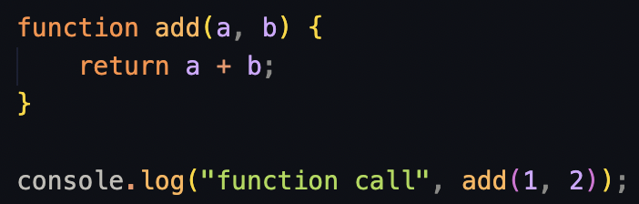
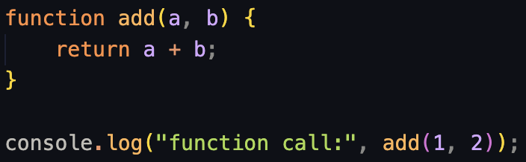

Function references

Slide 3
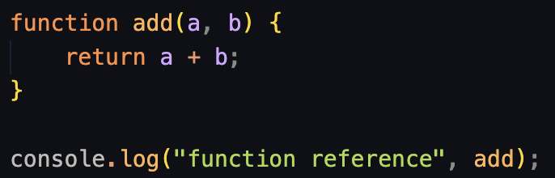
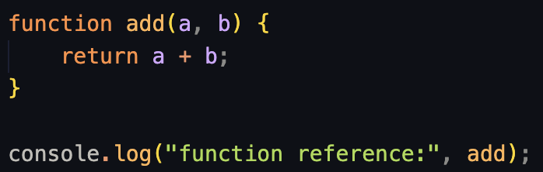
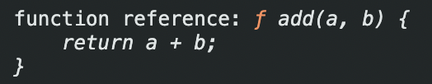
Function references

Slide 4


Function references
A “call” executes the code and outputs the return (if there’s one)
A “reference” points to the saved function

Slide 5
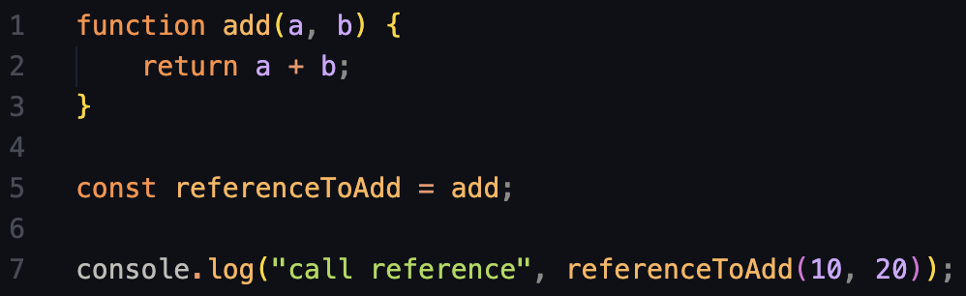
Function references
What will happen here?

Slide 6
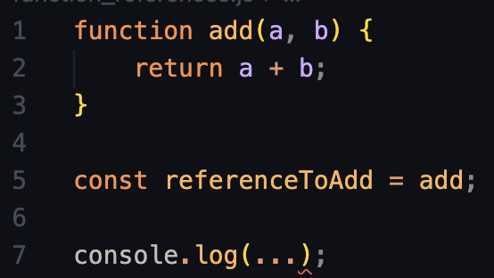
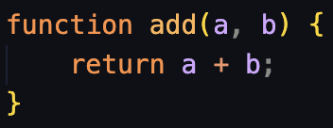
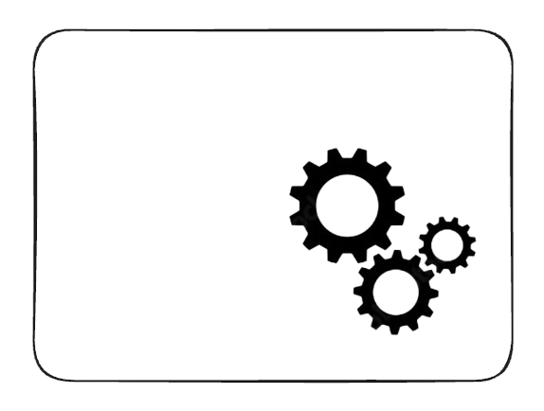
Function references
add
We create a new function called “add”

Slide 7


Function references
add
We save that function in a variable called “referenceToAdd”
ReferenceToAdd

Slide 8

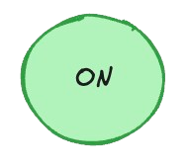
Function references
First, the computer looks for the function we saved and calls it.
When we “call” the function, the computer runs the code inside the body and “returns” the result.
add
ReferenceToAdd
30

Slide 9

Function references
add
Then it gets logged to the console.

Slide 10

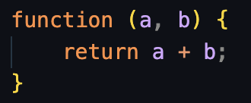
Anonymous functions
Anonymous means “without name”
But how do we call it?

Slide 11
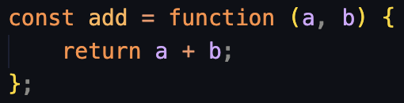
Anonymous functions
We can save it directly to a variable
Now we can call “add()” and it will run the code inside the body

